Slide 1
Energy of tomorrow

Slide 2
Summary
Context + Global Energy consumption forecast model
Energy mix and trends

Slide 3
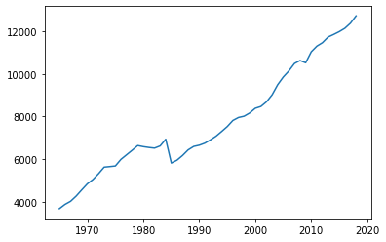
How will energy consumption evolve?
Global Primary energy consumption (Mtoe)
Global energy consumption has increased over the last decades reaching 13,865 Mtoe in 2018
Source: BP Statistical Review 2018

Slide 4
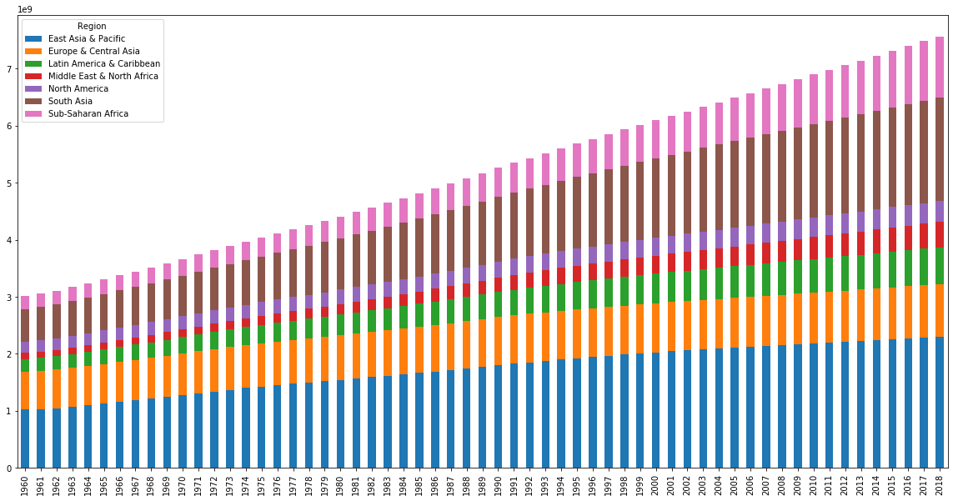
Population (Billion inhabitants)
Growth will be lead in part by population growth
Source: World Bank Data

Slide 5
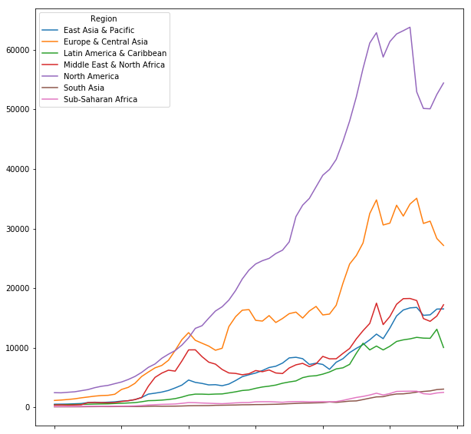
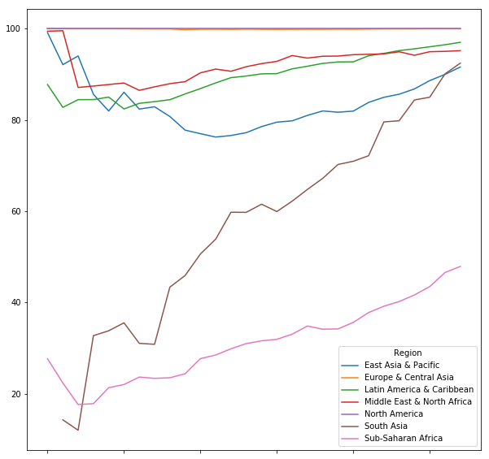
Some macroeconomics indicators
GDP per capita by region ($/capita)
Access to electricity (% of population)
Source: World Bank Data

Slide 6
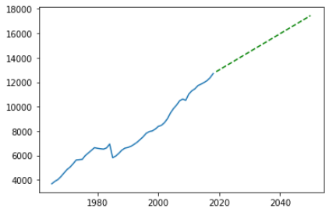
Energy consumption forecast (Mtoe)
Features: GDP per Capita, Population
Target: Energy consumption
Idea:
Fit a Linear model:
Energy Consumption = f (Population, GDP/c)
1965 - 2018
Build a Linear regression for each feature to forecast their values for 2019-2050
Predict Energy consumption values with the first model.
Possibility to adapt by sector, by region
Source: BP Statistical Review 2018, World Bank Data, Modelling

Slide 7
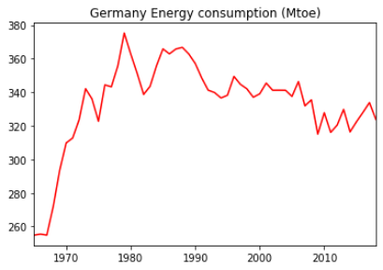
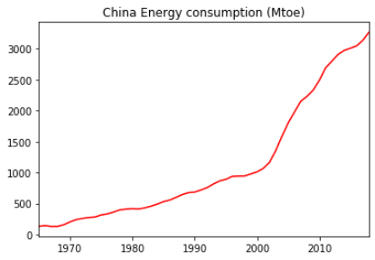
How will energy consumption evolve?
Unsurprisingly, the increase has been lead by emerging countries, which also lead economic growth.
OECD countries energy consumption has remained stable and/or decreased lately
Source: BP Statistical Review 2018

Slide 8
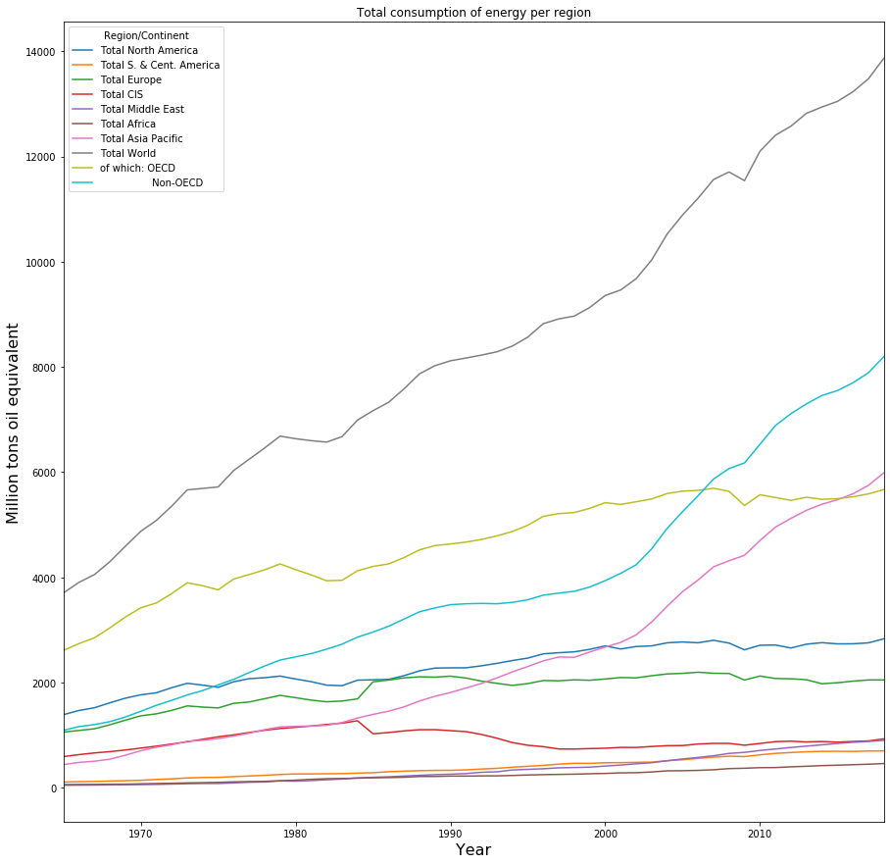
Worldwide ?
Not increasing everywhere
Source: BP Statistical Review 2018

Slide 9
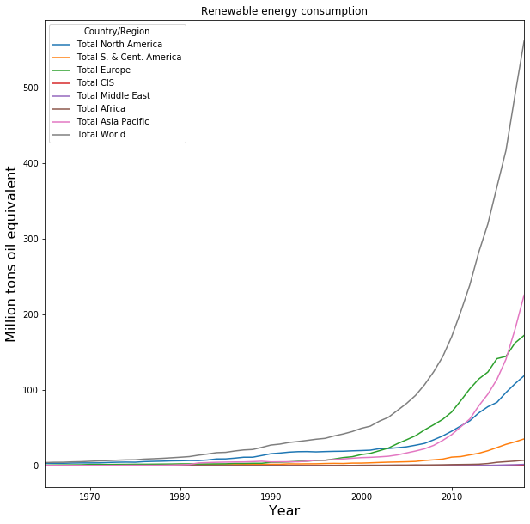
Renewable energies ?
Source: BP Statistical Review 2018

Slide 10
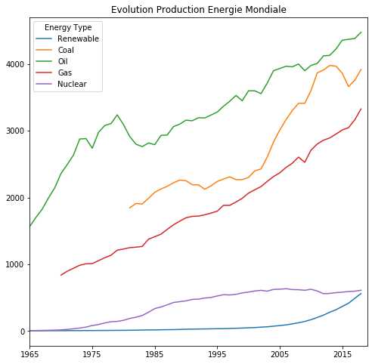
Source: BP Statistical Review 2018

Slide 11
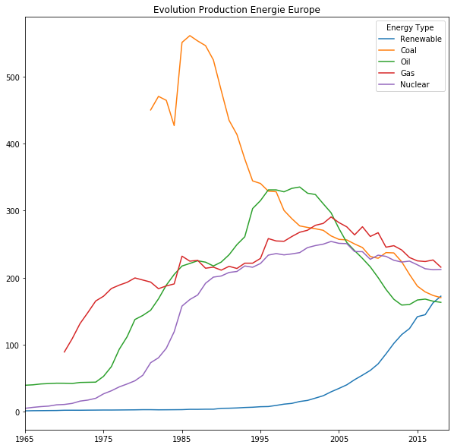
Europe
Source: BP Statistical Review 2018

Slide 12
